Slide 1

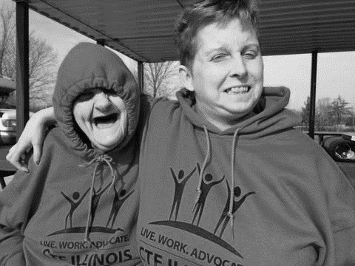
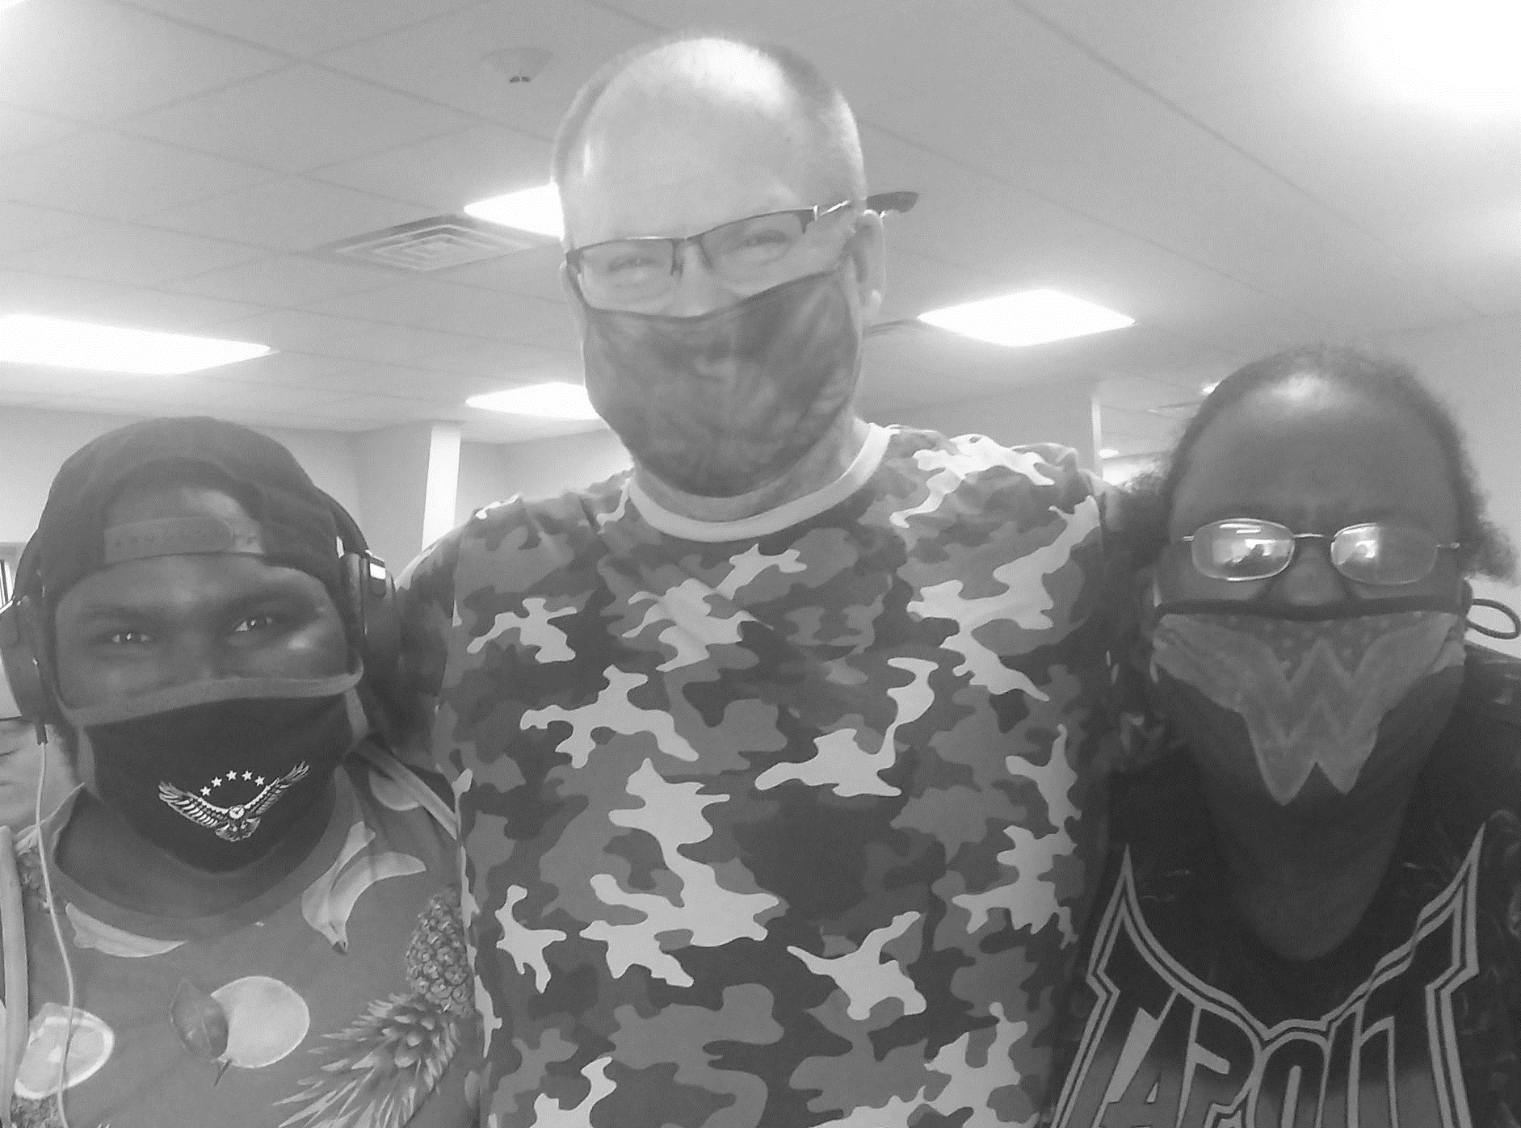

MISSION
Empowering each individual we serve to live the life they want to live
VISION
Creating a culture where people are not defined by their differences,
but recognized for the value they bring to their communities

Slide 2
LIVE. WORK. ADVOCATE.
At CTF ILLINOIS, we offer supports that follow the motto:
LIVE. WORK. ADVOCATE.
Through this motto, which focuses on three essential pillars of life, we help to fulfill our mission and vision and to make a lasting difference in the lives of those we support.
LIVE | WORK | ADVOCATE
Residential Supports Lifestyle Supports Mental Health Center Behavioral Support | Community Employment Community Day Services Virtual Classes Group Respite Support | Advocacy Centers Case Management Home-Based Services
LOCATIONS:
Chicago Suburbs, including Tinley Park, Orland Park, Palos Park, Crestwood, and South Holland
Downstate Area, including Champaign, Charleston, and Olney

Slide 3
WHY WORK FOR US?
FLEXIBILITY
We have a variety of shifts available to fit your lifestyle. This includes flexible or set schedules, full or part-time opportunities, and morning, evening, weekend, and overnight shifts.
BENEFITS AND GROWTH
We offer paid training, which includes a raise after completion of training as well as a raise after one year of service, competitive benefits, and opportunities to promote from within.
SAFETY PRECAUTIONS
We take extreme precautions to protect our employees and the people we support from COVID-19, with safety measures and protocols in place at each location.

Slide 4
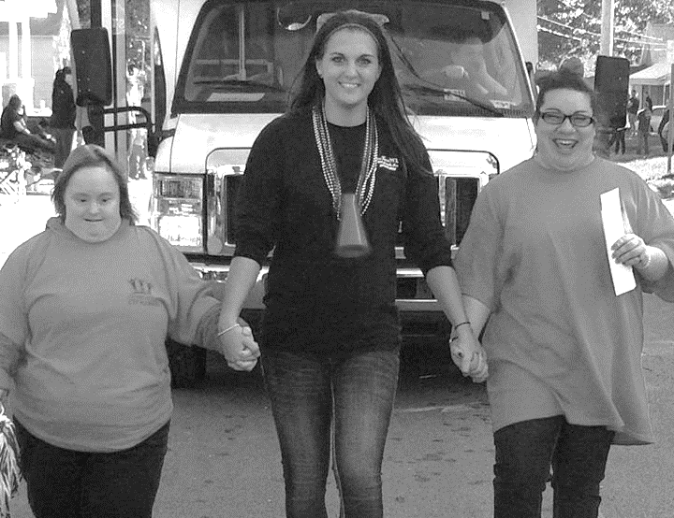
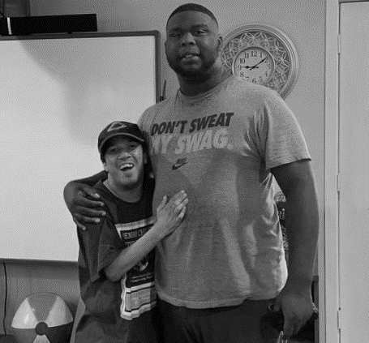
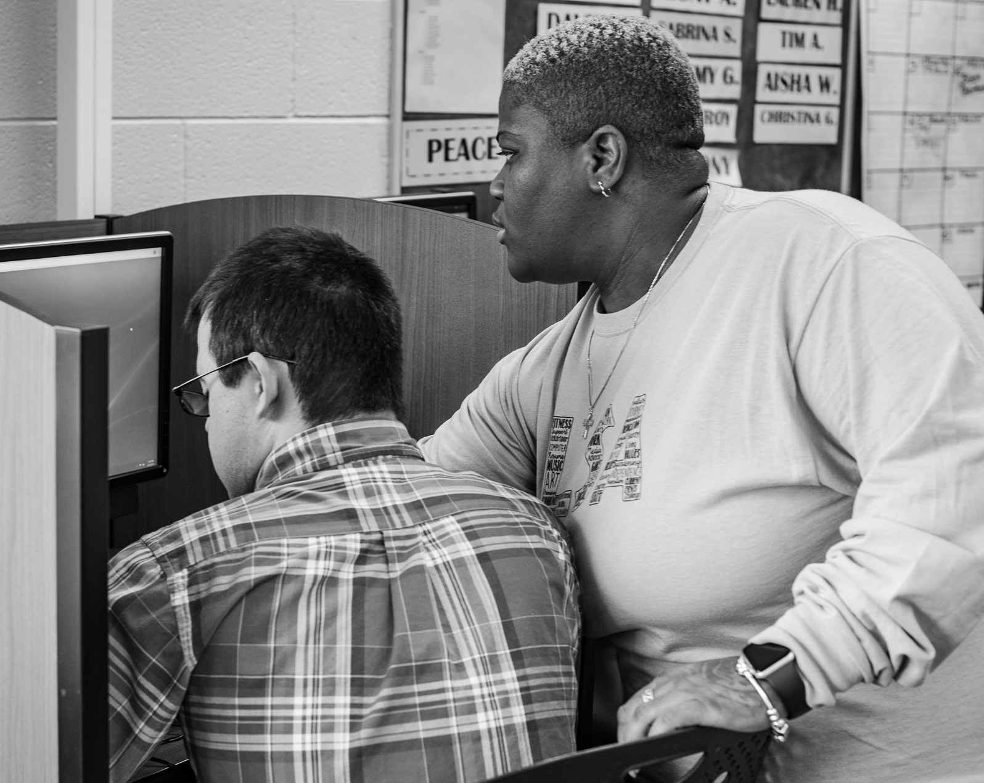
What are we looking for?
SOME WHO IS…
…ready to make a difference
…compassionate and caring
…not afraid of a challenge

Slide 5
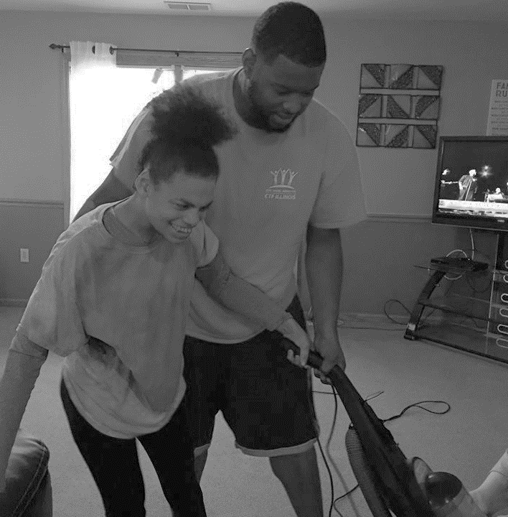
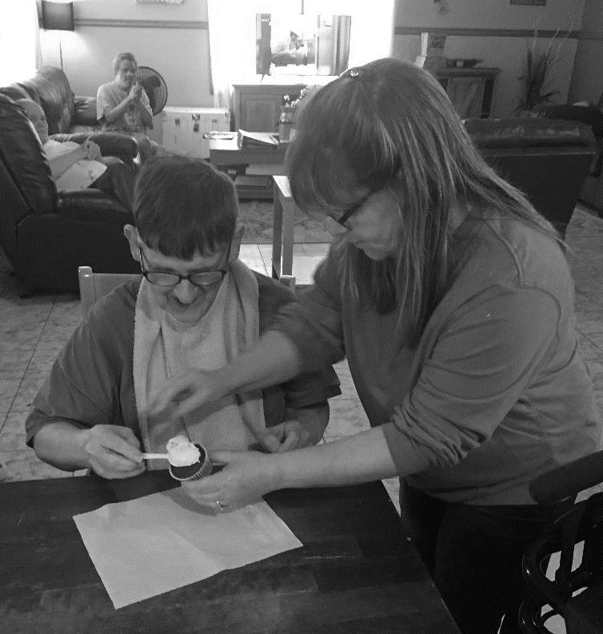
WHAT COULD YOU BE DOING?
Bathing, grooming, and helping with household duties
Assisting with errands
Encouraging independence for those we support
Engaging individuals with daily activities

Slide 6
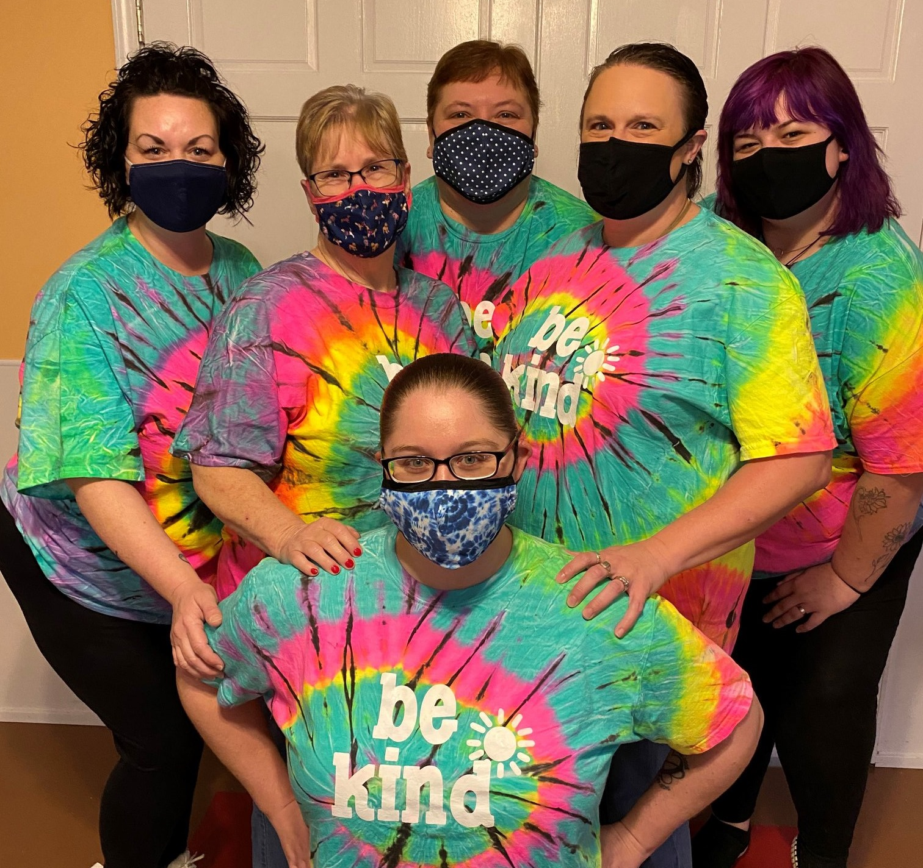
LIKE WHAT YOU SEE?
APPLY ONLINE:
www.ctfillinois.org

